Slide 1
Process-to-Process Delivery:
UDP, TCP
Dr. Mohit Kumar
Dept. of IT
NIT Jalandhar

Slide 2
23-1 PROCESS-TO-PROCESS DELIVERY
The transport layer is responsible for process-to-process delivery—the delivery of a packet, part of a message, from one process to another. Two processes communicate in a client/server relationship, as we will see later.
Topics discussed in this section:
Client/Server Paradigm
Multiplexing and Demultiplexing
Connectionless Versus Connection-Oriented Service
Reliable Versus Unreliable
Three Protocols

Slide 3

Note
The transport layer is responsible for process-to-process delivery.

Slide 4

Figure 23.1 Types of data deliveries

Slide 5
Client/Server Paradigm
A process on local host is called a client, needs services from a process usually on the remote host called a server.
We need a transport layer address, called a port number to choose among multiple processes running on destination host.
The destination port number is needed for delivery and source port number is needed for the reply.
The program defines itself with a port number, chosen randomly by the transport layer software running on client host, is ephemeral port number.
The server process must also define itself with a port number. However can not be chosen randomly.
23.<number>

Slide 6

Figure 23.2 Port numbers

Slide 7

Figure 23.3 IP addresses versus port numbers

Slide 8

Figure 23.4 IANA (Internet assigned number Authority) ranges

Slide 9
Well-known ports: The ports ranging from 0 to 1023 are assigned and controlled by lANA. These are the well-known ports.
Registered ports: The ports ranging from 1024 to 49,151 are not assigned or controlled by lANA. They can only be registered with lANA to prevent duplication.
Dynamic ports: The ports ranging from 49,152 to 65,535 are neither controlled nor registered. They can be used by any process. These are the ephemeral ports.

Slide 10

Figure 23.5 Socket address
Process to process delivery required two identifiers, IP address and port number at each end to make connection.
The combination of IP address and port address is called socket address.

Slide 11

Figure 23.6 Multiplexing and demultiplexing

Slide 12
Connectionless Service vs Connection-Oriented Service
Connectionless Service:
  In a connectionless service, the packets are sent from one party to another with no need for connection establishment or connection release.
  The packets are not numbered; they may be delayed or lost or may arrive out of sequence.
  There is no acknowledgment either.
  UDP, is connectionless.
Connection-Oriented Service:
  In a connection-oriented service, a connection is first established between the sender and the receiver.
  Data are transferred.
  At the end, the connection is released.
  TCP and SCTP are connection-oriented protocols

Slide 13
Reliable Versus Unreliable
The transport layer service can be reliable or unreliable.
If the application layer program needs reliability, we use a reliable transport layer protocol by implementing flow and error control at the transport layer.
This means a slower and more complex service.
On the other hand, if the application program does not need reliability because it uses its own flow and error control mechanism or it needs fast service or the nature of the service does not demand flow and error control (real-time applications), then an unreliable protocol can be used.
In the Internet, there are three common different transport layer protocols, as we have already mentioned.
UDP is connectionless and unreliable;
TCP and SCTP are connection-oriented and reliable.

Slide 14

Figure 23.7 Error control

Slide 15

Figure 23.8 Position of UDP, TCP, and SCTP in TCP/IP suite

Slide 16
23-2 USER DATAGRAM PROTOCOL (UDP)
The User Datagram Protocol (UDP) is called a connectionless, unreliable transport protocol. It does not add anything to the services of IP except to provide process-to-process communication instead of host-to-host communication.
Topics discussed in this section:
Well-Known Ports for UDP
User Datagram
Checksum
UDP Operation
Use of UDP

Slide 17


Table 23.1 Well-known ports used with UDP

Slide 18

Figure 23.9 User datagram format

Slide 19
Note
UDP length
= IP length – IP header’s length

Slide 20

Figure 23.10 Pseudoheader for checksum calculation

Slide 21

Figure 23.12 Queues in UDP

Slide 22
23-3 TCP
TCP is a connection-oriented protocol; it creates a virtual connection between two TCPs to send data. In addition, TCP uses flow and error control mechanisms at the transport level.
Topics discussed in this section:
TCP Services
TCP Features
Segment
A TCP Connection
Flow Control
Error Control

Slide 23

Table 23.2 Well-known ports used by TCP

Slide 24

Figure 23.13 Stream delivery

Slide 25
Note
The bytes of data being transferred in each connection are numbered by TCP.
The numbering starts with a randomly generated number.

Slide 26

Example 23.3
The following shows the sequence number for each segment:

Slide 27
Note
The value in the sequence number field of a segment defines the
number of the first data byte
contained in that segment.

Slide 28
Note
The value of the acknowledgment field in a segment defines
the number of the next byte a party expects to receive.
The acknowledgment number is cumulative.

Slide 29

Figure 23.16 TCP segment format

Slide 30

Figure 23.17 Control field

Slide 31

Table 23.3 Description of flags in the control field

Slide 32

Figure 23.18 Connection establishment using three-way handshaking

Slide 33
Note
A SYN segment cannot carry data, but it consumes one sequence number.

Slide 34
Note
A SYN + ACK segment cannot
carry data, but does consume one
sequence number.

Slide 35
Note
An ACK segment, if carrying no data, consumes no sequence number.

Slide 36

Figure 23.19 Data transfer

Slide 37

Figure 23.20 Connection termination using three-way handshaking

Slide 38
Note
The FIN segment consumes one sequence number if it does
not carry data.

Slide 39
Note
The FIN + ACK segment consumes
one sequence number if it
does not carry data.

Slide 40

Figure 23.21 Half-close

Slide 41

Figure 23.22 Sliding window

Slide 42
Note
A sliding window is used to make transmission more efficient as well as
to control the flow of data so that the destination does not become
overwhelmed with data.
TCP sliding windows are byte-oriented.

Slide 43
Example 23.4
What is the value of the receiver window (rwnd) for host A if the receiver, host B, has a buffer size of 5000 bytes and 1000 bytes of received and unprocessed data?
Solution
The value of rwnd = 5000 − 1000 = 4000. Host B can receive only 4000 bytes of data before overflowing its buffer. Host B advertises this value in its next segment to A.

Slide 44
Example 23.5
What is the size of the window for host A if the value of rwnd is 3000 bytes and the value of cwnd is 3500 bytes?
Solution
The size of the window is the smaller of rwnd and cwnd, which is 3000 bytes.

Slide 45
Example 23.6
Figure 23.23 shows an unrealistic example of a sliding window. The sender has sent bytes up to 202. We assume that cwnd is 20 (in reality this value is thousands of bytes). The receiver has sent an acknowledgment number of 200 with an rwnd of 9 bytes (in reality this value is thousands of bytes). The size of the sender window is the minimum of rwnd and cwnd, or 9 bytes. Bytes 200 to 202 are sent, but not acknowledged. Bytes 203 to 208 can be sent without worrying about acknowledgment. Bytes 209 and above cannot be sent.

Slide 46

Figure 23.23 Example 23.6

Slide 47
Note
Some points about TCP sliding windows:
❏ The size of the window is the lesser of rwnd and
cwnd.
❏ The source does not have to send a full window’s
worth of data.
❏ The window can be opened or closed by the
receiver, but should not be shrunk.
❏ The destination can send an acknowledgment at
any time as long as it does not result in a shrinking
window.

Slide 48
Note
In modern implementations, a retransmission occurs if the retransmission timer expires or three duplicate ACK segments have arrived.

Slide 49
Note
Data may arrive out of order and be temporarily stored by the receiving TCP,
but TCP guarantees that no out-of-order segment is delivered to the process.

Slide 50
Note
The receiver TCP delivers only ordered data to the process.

Slide 51
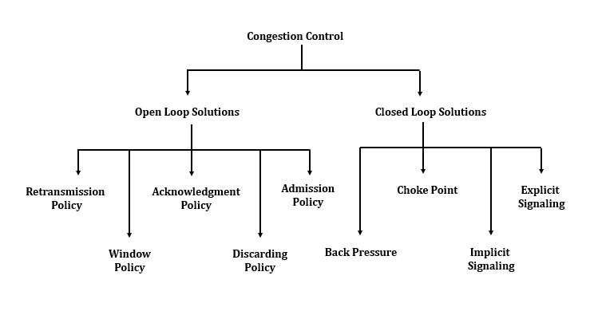
CONGESTION CONTROL
Congestion control in TCP is based on both open loop and closed-loop mechanisms.
TCP uses a congestion window and a congestion policy that avoid congestion and detect and alleviate congestion after it has occurred.
Congestion Window
Congestion Policy

Slide 52
TCP Congestion Control
Slow Start: Exponential Increase
Congestion Avoidance: Additive Increase
Congestion Detection: Multiplicative Decrease

Slide 53
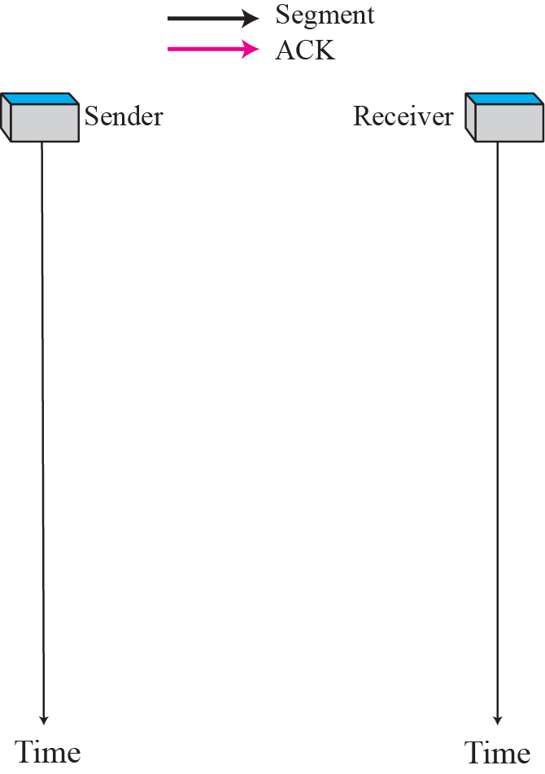
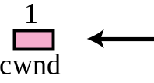
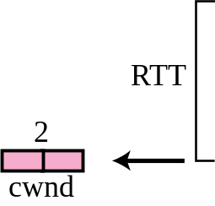
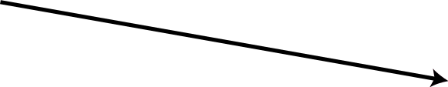

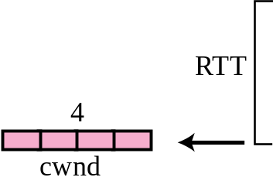
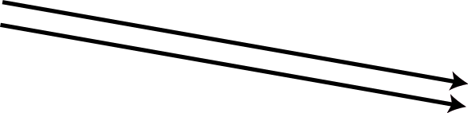
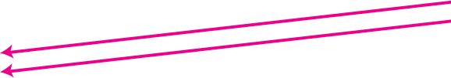
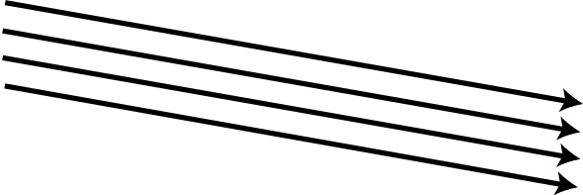
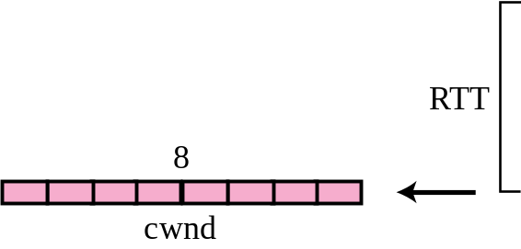
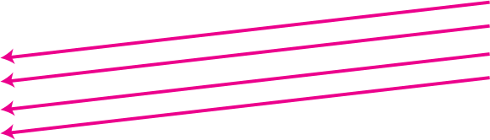
Figure 34 Slow start, exponential increase

Slide 54
Note
In the slow start algorithm, the size of the congestion window increases exponentially until it reaches a threshold.

Slide 55
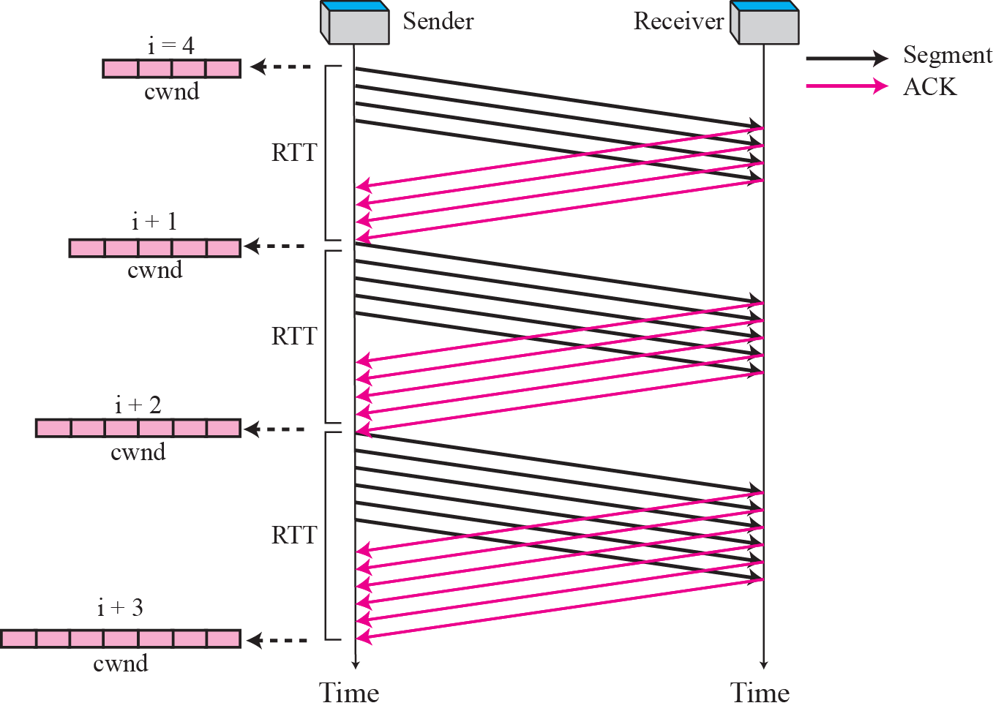
Figure 35 Congestion avoidance, additive increase

Slide 56
Note
In the congestion avoidance algorithm the size of the congestion window
increases additively until
congestion is detected.

Slide 57
Congestion Detection: Multiplicative Decrease
If congestion occurs, size of congestion window must be decreased.
  If a time-out occurs (Strong possibility)
    Set the value of the threshold to one half of the current window size.
    It sets the cwnd to the size of one segment.
    Starts slow start.

Slide 58
Congestion Detection: Multiplicative Decrease
  If Three ACK are received (Weak possibility)
    Set the value of the threshold to one half of the current window size.
    It sets the cwnd to the value of threshold.
    Starts congestion avoidance.

Slide 59
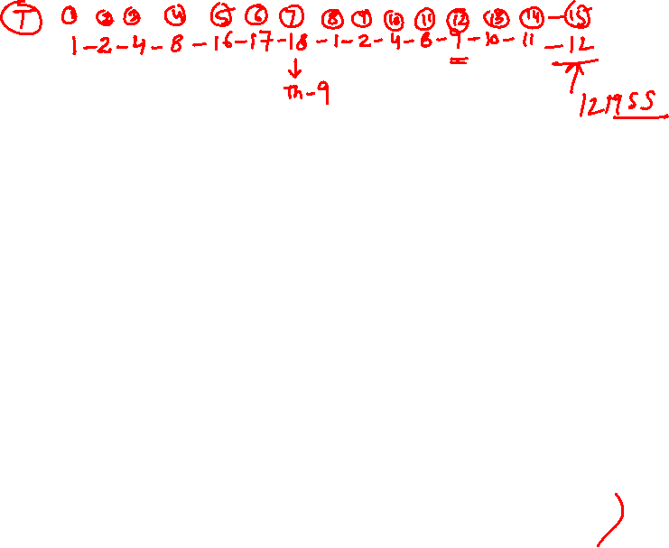
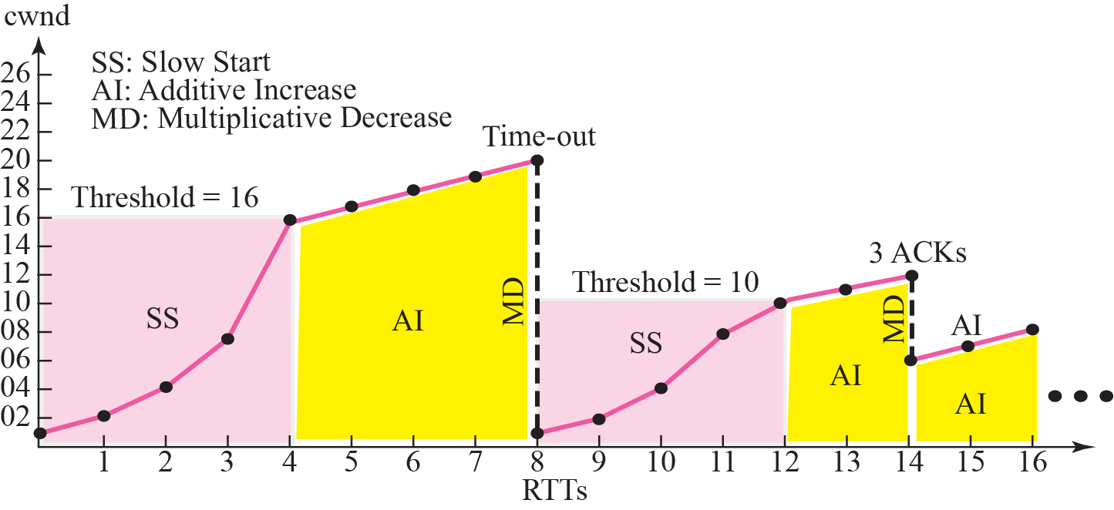
Figure 37 Congestion example

